Slide 1

COVID-19 Pandemic and Adaptive
Publishing Patterns in Indonesia
Finarya Legoh
Indonesian Academy of Sciences (AIPI)
International Relation & Funding
finaryalegoh@gmail.com; finarya.legoh@dipi.id

Slide 2
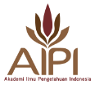
CONTENT
AIPI Profile
References Published by AIPI
Scholar Open Access in Indonesia
COVID-19 Negative & Positive Impacts on Higher Education and R&D
Summaries

Slide 3
PROFILE:
Indonesian Academy of Sciences (AIPI)
As an independent institution, AIPI was established under the Law of the Republic of Indonesia No.8/1990.
Main roles: to provide opinion and consideration in reviewing and setting directions related to the mastery, development and utilization of excellence science and technology; through science-based statement, report, white paper and foresight studies, for the benefit of the nation.
AIPI assures scientific culture of excellence and science literate society in Indonesia, as to develop the ability in providing in-depth policy advocacy, evidence synthesis, systematic review and consensus report through collaboration with national & international stakeholders.
The products: reference publications, consensus reports / studies / insights / statements, policy briefs, public outreach, white paper, foresights – all are evaluated by evidence / scientific-based.

Slide 4
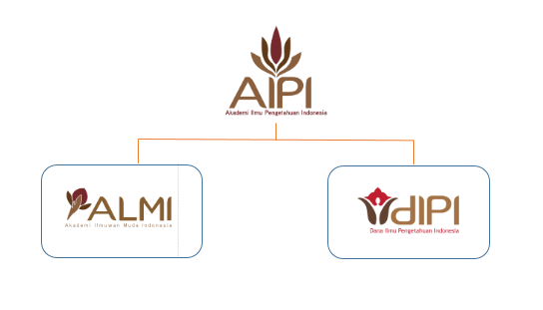
PROFILE:
Indonesian Academy of Sciences (AIPI)
5
5 commissions :
Basic Science, Engineering,
Medical Science,
Social Science, Culture
Under the auspices of AIPI, 2 institutes established in 2016:
Indonesian Science Fund (DIPI): its main role to spur the development of scientific excellence. DIPI formulates and organizes funds for research grants based on merit excellence competition – Indonesian scientists able to collaborate internationally and to carry out more meaningful and fundamental research on an ongoing basis.
Indonesian Young Academy of Sciences (ALMI): its main role is to upkeep the enabling-environment in the development of frontier science and technology in Indonesia for the future.

Slide 5

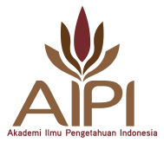
PROFILE:
Indonesian Academy of Sciences (AIPI)
AIPI is the member of the Association of Academies and Societies of Sciences in Asia (AASSA).
AASSA is an independent body & non-profit international organization with science, technology and innovation (STI) interests. It consists of S&T academies in Asia and Oceania [http://aassa.asia]
Its current members are 32 academies & societies of 30 countries and 1 regional academy of engineering & technology.
Many activities of academies have been done under the collaboration of AASSA and IAP (InterAcademy Partnership) – the global network of science, engineering & medical academies working together to provide independent expert advice.

Slide 6
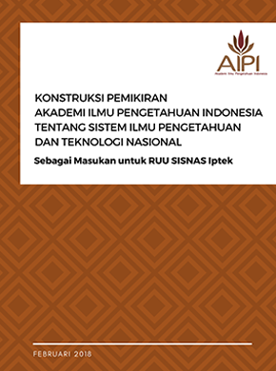
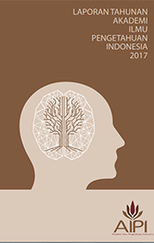
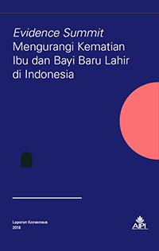
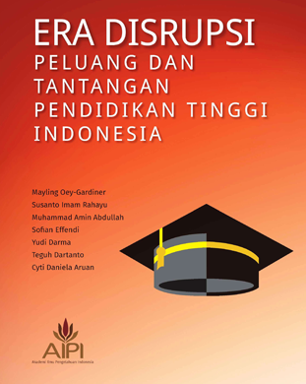
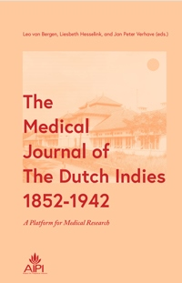
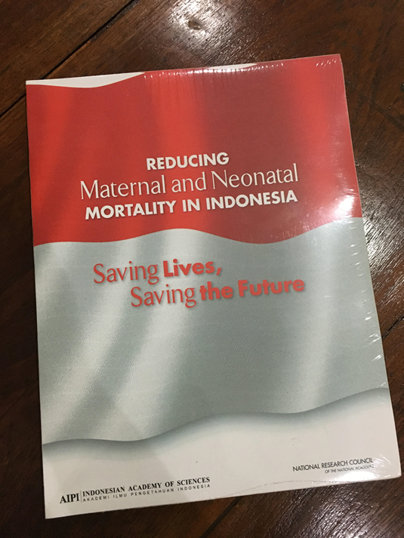
EXAMPLES OF PUBLICATIONS:
Produced by AIPI

Slide 7
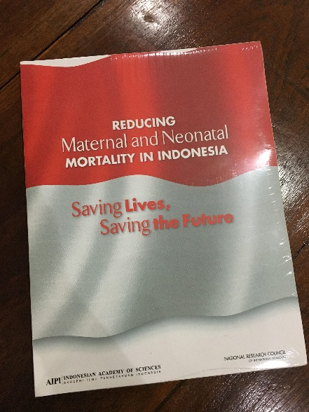
Reducing Maternal and Neonatal Mortality in Indonesia (joint report by US NRC & AIPI)
Major findings:
The current state of progress in addressing maternal and neonatal mortality in Indonesia is largely unknown.
“A major finding of this study is the lack of certainty (even within a fairly wide margin of error) of exactly what has happened to maternal mortality in Indonesia over the last few decades. In the absence of an adequate vital registration system, the various survey-based estimates differ so widely and often have such large margins of error that it is virtually impossible to determine exactly where the country was in the base year of 1990 and where it is today.”

Slide 8




White Paper on Science Technology and Higher Education Towards Indonesia 2045
High economic growth, inclusive
HE institutions are dependent to GOI funding
HE institutions are responsive to market-demands
*free download on www.aipi.or.id
High disparity and low economic growth

Slide 9
White Paper on Challenges and Opportunities of Higher Education in Indonesia
All publications / references published by AIPI are free and open access for the electronic versions in Indonesian or in English, can be downloaded from the website: www.aipi.or.id

Slide 10
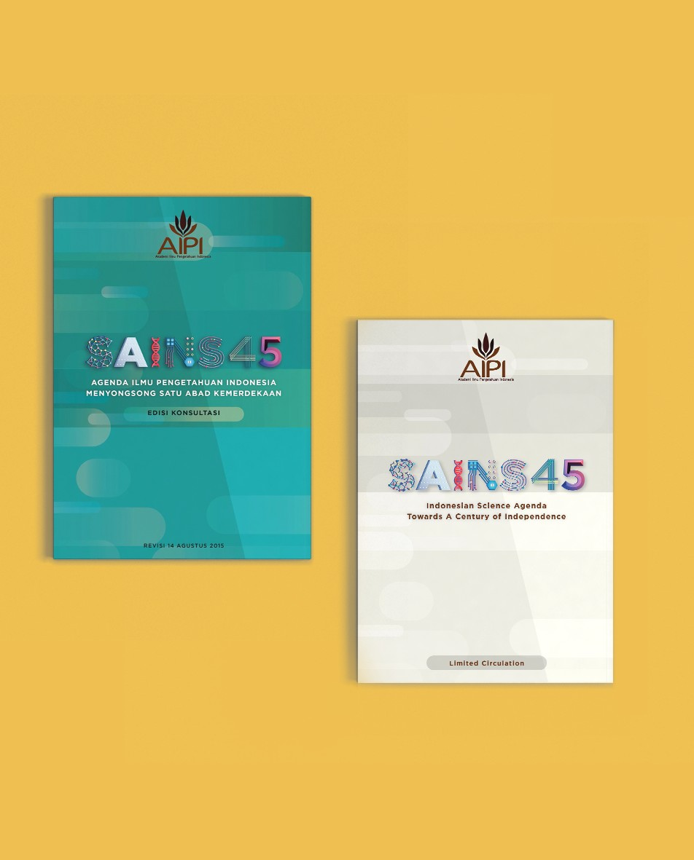
An Indonesian Science Agenda Towards a Century of Independence
SAINS45
*free download on www.aipi.or.id

Slide 11
Inputs for the Law of Indonesian National System of Science & Technology

Slide 12
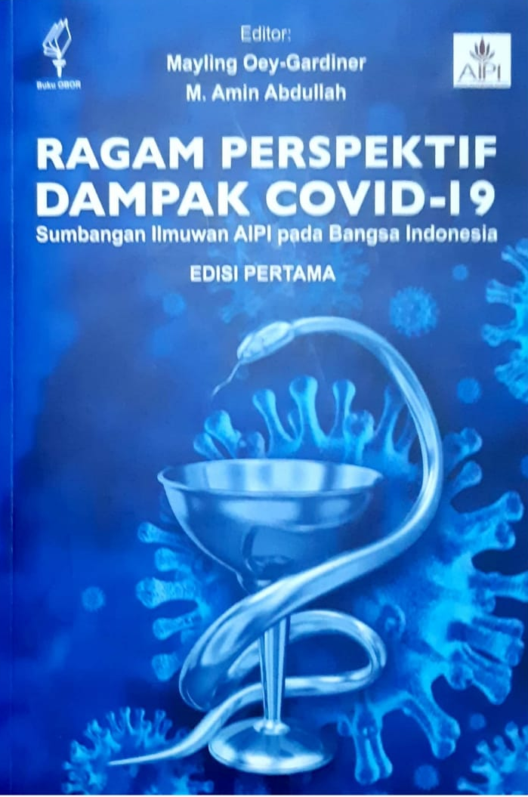
Latest publication:
@ Dec 2020
Various perspective on the COVID-19 impacts
Review written by AIPI fellows
Perspective on the impacts in health, socio culture and religion.
There will be a second publication

Slide 13
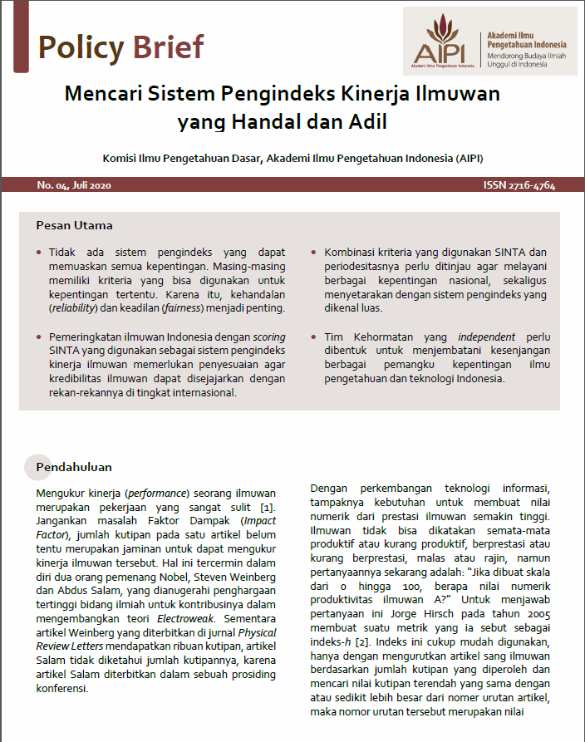
AIPI’S POLICY BRIEFS
PB No. 01, January 2020: Reviewing Land Use Policy and Sustainability of Palm Oil Sector in Indonesia
PB No. 02, April 2020: Maintaining Sovereignty in Building the Nation and Realizing the Maritime State of Indonesia
PB No. 03, May 2020: Integrated National Policy Towards an Earthquake Resilient Nation in Indonesia
PB No. 04, July 2020: Finding a reliable and Fair Scientists’ Performance Indexing System
PB No. 05, August 2020: Mainstreaming Bioeconomy in Indonesia
AIPI Insights: Anticipating COVID-19 Pandemic Impacts on Food Insecurity and Nutrition

Slide 14
Scholar Open Access in Indonesia
Open Access will be discussed based on the access to Scientific Publications in Indonesia.
Most of the Scientific Indonesian Journals and other publications, published mainly by Universities and Research Institute, are indexed in platform SINTA (Science and Technology Index), operated by the Ministry of Research and Technology; SINTA was started in 2016 and operates together with several other platforms. [https://www.sinta.ristekbrin.go.id/].
An Open Access Communities is also available for those who has interest in this field [https://openaccessid.weebly.com/].
To carry the Open Access activities, ICT Infrastructure is a must

Slide 15
Scholar Open Access in Indonesia
SINTA is basically the integrator of many data bases of scientific Publications in Indonesia, from journals, Books, Authors, Subjects, IPRs etc; SINTA also provides Information on publications from other countries too. In addition, SINTA also carry out analysis of the research institutions up to the position of Indonesia in research activities Globally;
The Ministry also operates several other platforms for various purposes, integrated with SINTA.
GARUDA provide detail information on most of the Journals, Articles, Conference Proceedings etc published In Indonesia [https://garuda.ristekbrin.go.id/].
RAMA is the Repository of University Students’ Final Projects; So, detail of the projects from various Universities can be found here [https://rama.ristekbrin.go.id/].
source: A. Sasongko in DSC Webinar

Slide 16
Scholar Open Access in Indonesia
ANJANI is the platform to support integrity of Scientific Indonesian Publications; It provides software to check similarity of publications so that Plagiarism can be avoided. The data source mainly derived from SINTA, RAMA and GARUDA. It even provides facility to report fraud in publications [http://anjani.ristekbrin.go.id/].
ARJUNA provides information on Accreditation of Journals [http://arjuna.ristekbrin.go.id/].
Other portals integrated with SINTA for various Information are available too.
The Open Access Community, provides information on various open journals and publications, as well as information on various related activities.
source: A. Sasongko in DSC Webinar

Slide 17
Scholar Open Access in Indonesia
Many Indonesia journals are listed in various portals globally related to Open Access, such as DOAJ (Directory of Open Access Journals):
https://doaj.org/search/journals?%23=%23.Wv__6IiFM2w&source=%7B%22query%22%3A%7B%22match_all%22%3A%7B%7D%7D%2C%22size%22%3A50%2C%22sort%22%3A%5B%7B%22created_date%22%3A%7B%22order%22%3A%22desc%22%7D%7D%5D%7D#.Wv__6IiFM2w
To operate Open Access (OA) platforms smoothly, have to be supported by:
  Availability of ICT infrastructure (speed, bandwidth)
  Availability of proper internet access (continuous access)

Slide 18
When COVID-19 arrives
Indonesia Government has setting a website: https://www.covid19.go.id/ to inform public about COVID-19 (register for vaccinated, information of various vaccine and what are available – astra zenica, cinovax, Pfizer, etc., hoax busters, what must do if infected, individual isolation or hospitalized, Q&A, ongoing research for COVID, do and don’t, etc. The website is maintained by Ministry of Health and supported by COVID-19 task Force and experts / researchers in related area.
Indonesia Government establishes the National Task Force for COVID-19 led by the President, which divine policies for new normal, especially in stimulating economy recovery with strict implementation of health protocol (integrating economy, health and social welfare), regarding the national focus in 2020 and 2021. The Task Force members consist of experts including AIPI fellows.

Slide 19
When COVID-19 arrives
Beside the Government, scientists also contribute information to public, especially to combat false information / hoax about the pandemic & vaccine, in the form of Booklet, Q&A flyer, short video, podcast; presidential / governor talk or appeal, public figure / celebrity scientist podcast; all disseminated throughout social media.
Internet users in Indonesia are high, and 90% using smart phone every day to access internet, which 50% is for social media, 33% for working, and the rest for others) [APJII (Association of Indonesian Internet Service) Survey 2020]. Social media used: whatapps, Instagram, twitter, youtube, facebook, messeger, etc.
Scholar information, journals, research publications, especially regarding health / COVID, published in usually Closed Access publications, now they are becoming published in Open Access.

Slide 20
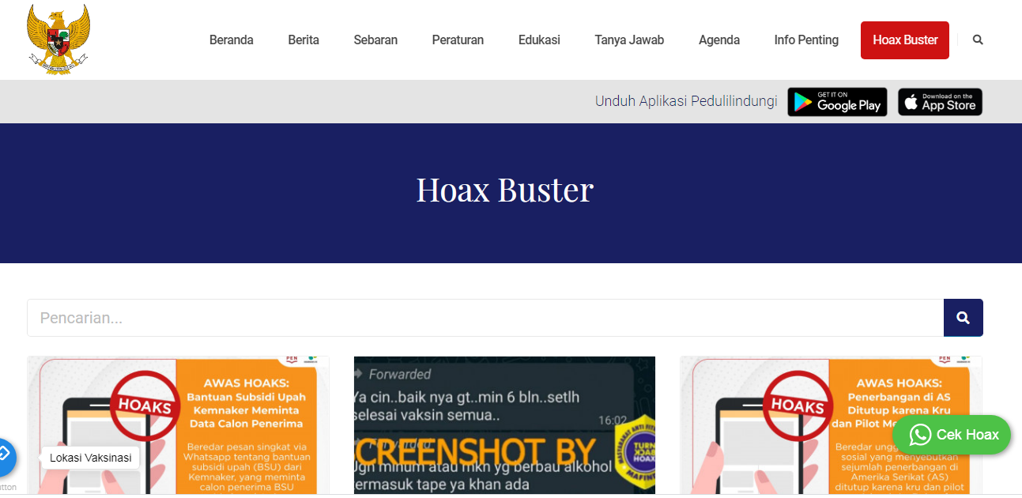
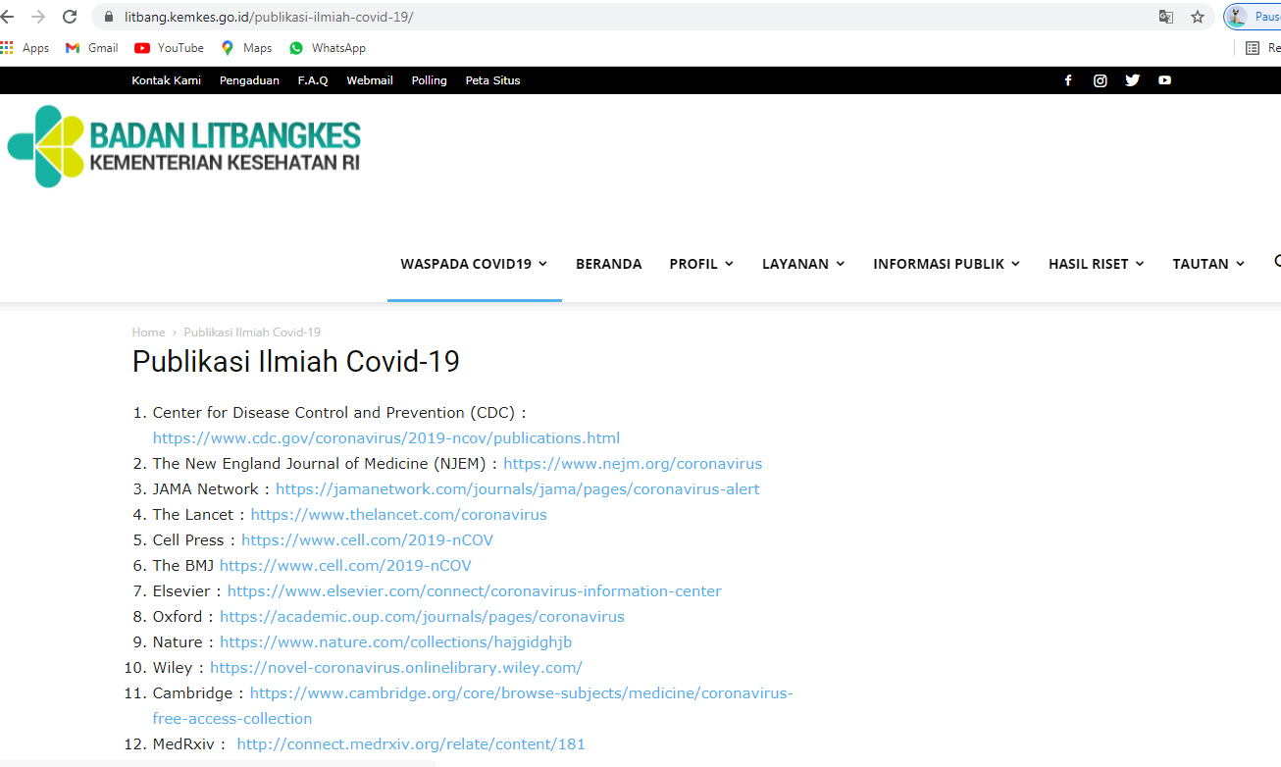

Slide 21
COVID-19 Negative Impact on
Higher Education & R&D
Temporary closure of all educational institutions as an effort to prevent COVID-19 spread - has impact on millions of students, including in Indonesia.
R&D has an impact too due to closure of laboratories, hinder of visit exchange & discussion, prevention on field surveys, WFH.
Disturbances in teaching and research process directly, cooperation, as well as assessment & evaluation, making scientific report, etc. causing a decrease in skill quality and timeline stated.
Negative impact of distance learning for students: inadequate networks, students lacking understanding of learning materials, students feeling less enthusiastic about participating in online learning, limited facilities in online learning made it difficult for students, and expensive internet quotas.

Slide 22
COVID-19 Negative Impact on
Higher Education & R&D
For lecturers / researchers: need to learn various platforms to communicate / to do assignment / to do research work / to exchange results safely.
This burden is the responsibility of all elements of education / R&D. The government in particular, in facilitating the policy & infrastructure of education continuity for all stakeholders, to conduct distance learning and research - should plan and prepare for and overcome recovery COVID-19, to reduce the loss of education in the future.
Open Access platform becomes more important for R&D and publication. OA can be operated smoothly if ICT infrastructure is available and supported by proper internet access. This is the problems for rural & remote areas in Indonesia. Only big cities and urban areas can be served properly by the facilities.

Slide 23
COVID-19 Positive Impact on
Higher Education & R&D
Rapid development of technology-based education: new teaching & learning platform & applications, laboratory apps, training, etc., online discussion with no limitation in distance and real meeting point.
Emergence and a must learning about new technology-based scholar communication & discussion; positive mental building in creativity.
Increasing people in searching information / surfing internet / exploring on e-books / references / journals and other resources from the internet – broaden knowledge perspectives and eagerness to submit papers.
Make possible to gain advice needed and setting discussion with experts / colleagues from abroad – consider for time difference & communication platform.
Make process of publication of proceeding / journal easier.

Slide 24
COVID-19 Positive Impact on
Higher Education & R&D
Online learning is more practical – delivery of information is faster, reaching more students / lecturers.
Gaining new experience and knowledge about various online platforms – reporting, assignment, evaluation, assessment, etc.
As work from home, make people more creative & productive:
  They create various platforms, apps, methods, trainings.
  The online system can reach people in the rural areas as well as internationally.
  More collaborations are also created due to non limitation of joint research (as far as funding permitted) especially in the field of COVID-19 – produce more joint papers.
  They submit more papers about COVID and its relevance, about the online system, platform, education online system, surveys, etc. as well as from various fields of research.

Slide 25
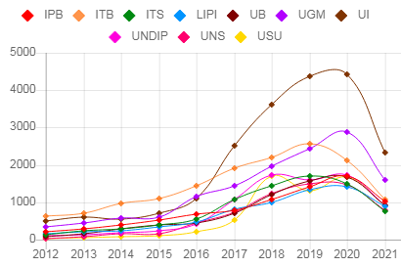
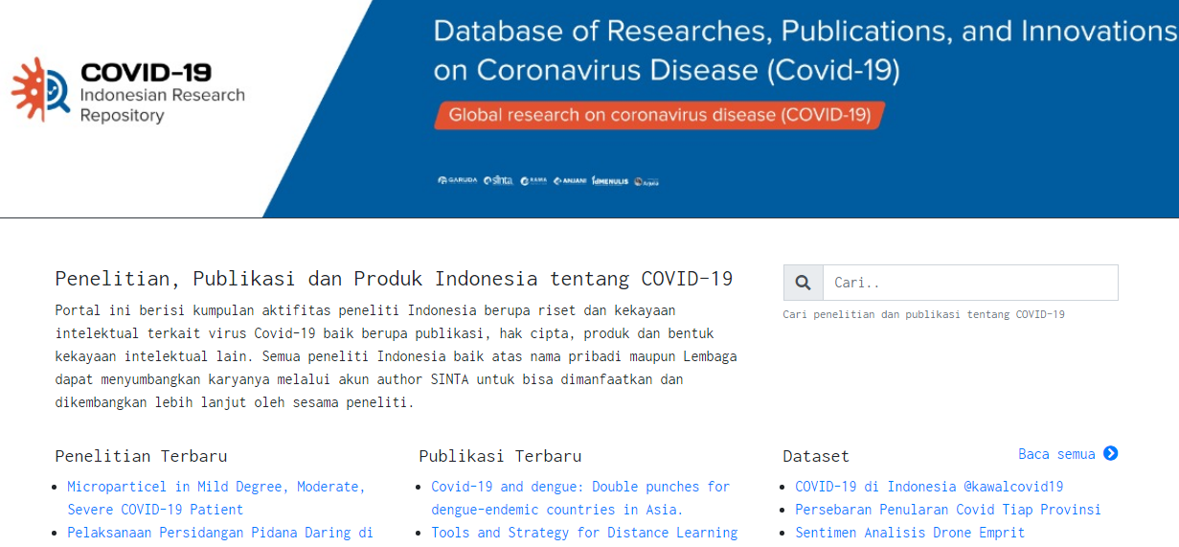
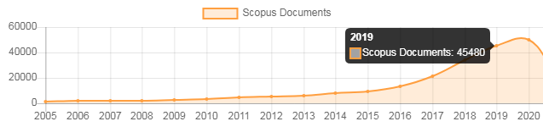
COVID-19 Positive Impact on
Higher Education & R&D
2020: 49,947
source: www.sinta.ristekbrin.go.id

Slide 26
WHAT WE ARE DOING:
to overcome negative impacts
Government develops & expands ICT infrastructure in rural & remote areas, which is non profitable in business but a must; it is provided through terrestrial and satellite - targeted by end 2022 can be provided.
Government supports for the quota of internet data package for low income community to continue education from home – has a positive response.
Due to WFH, students / lectures who need learning by doing have the exception to enter laboratories / studios with strict health protocol.
Learning management System (LMS) are developed rapidly which design is planned to be integrated from one campus to another. The Ministry of Education, Culture, Research & technology provides LMS with various programs and features.

Slide 27
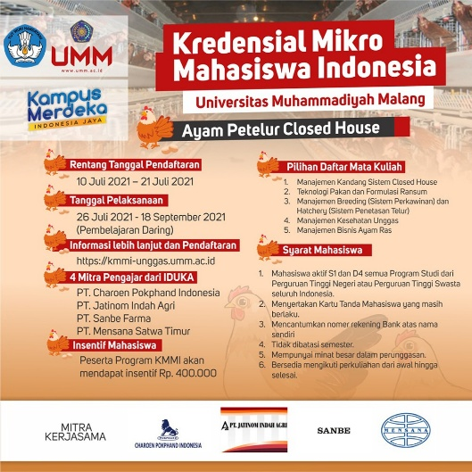
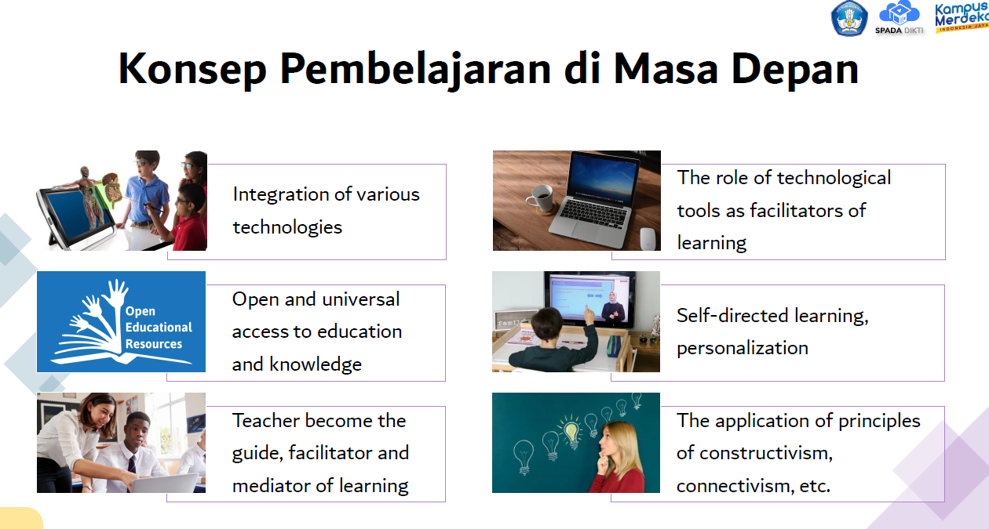
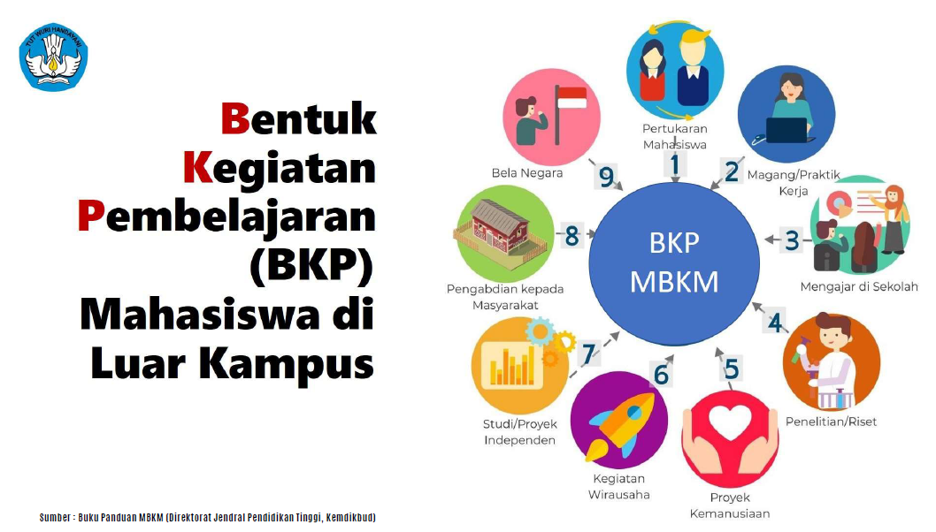
WHAT WE ARE DOING:
Online Applications & Programs
Lecturing & student learning activities off campus
Source: Ministry of Education, Culture, Science & Technology

Slide 28
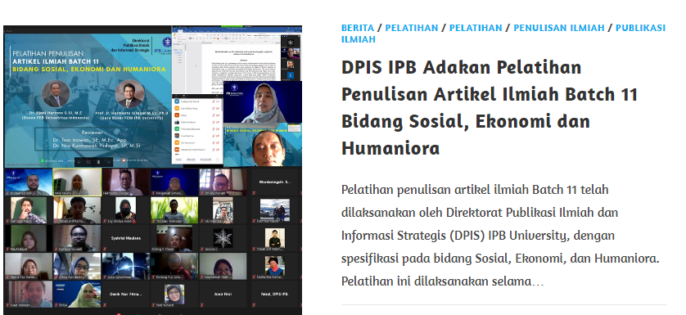
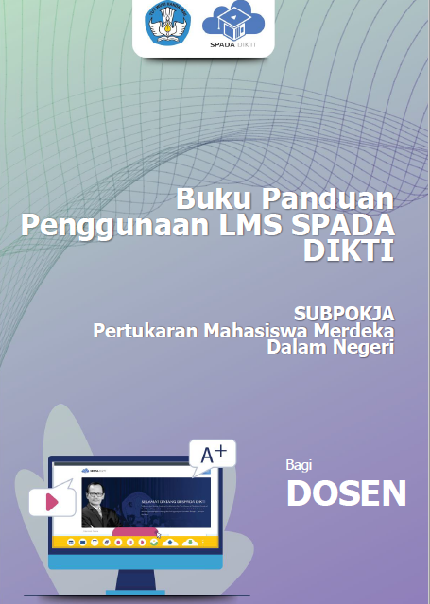
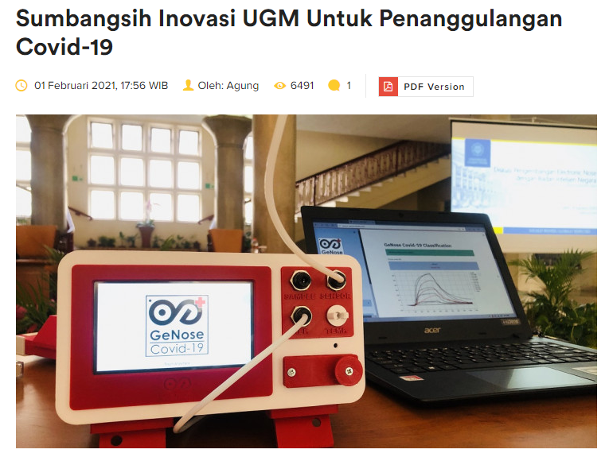
Various online activities & LMS guideline for lecturers
Source: University of IPB & Gajah Mada (UGM)
Source: Ministry of Education, Culture, Science & Technology

Slide 29
SUMMARIES
COVID-19 enforces online activities & hastens ICT infrastructures development. It gives benefit to rural & remote areas in getting the advantage of Open Access platform and communication.
The emergence of continuity of education – LMS with various applications and programs for students, teachers & lecturers.
The emergence of finding vaccine, healing medication, and other related research, made the R&D works intensively, resulting more publication within the pandemic term.
The restriction of WFH and social distancing create more creativity and productivity in terms of R&D and publications in many cases across various related subjects.
Increased scientific publications and the needs to be accessed by many researchers for the advancement of S&T and combatting COVID-19 - many research especially on COVID published in usual Closed Access publications, are now becoming published in Open Access.

Slide 30
THANK YOU SHUKRAN
The Indonesian Academy of Sciences (AIPI)
National Library Complex
Floor # 17-18
Jakarta 10110, Indonesia
info@aipi.or.id
www.aipi.or.id

